Slide 1
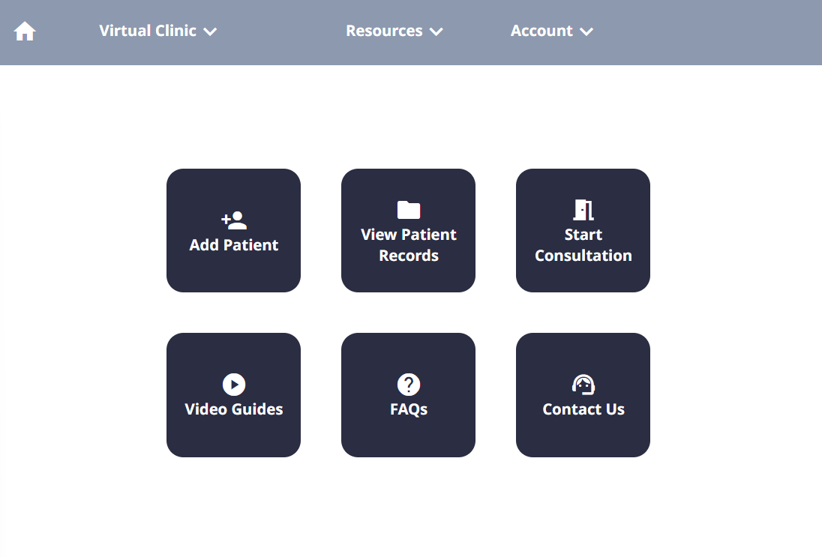
Welcome to Tutorial 4.
Let’s jump in and start the consultation again for James Jameson.
(This time, there’s no hints!)

Slide 2
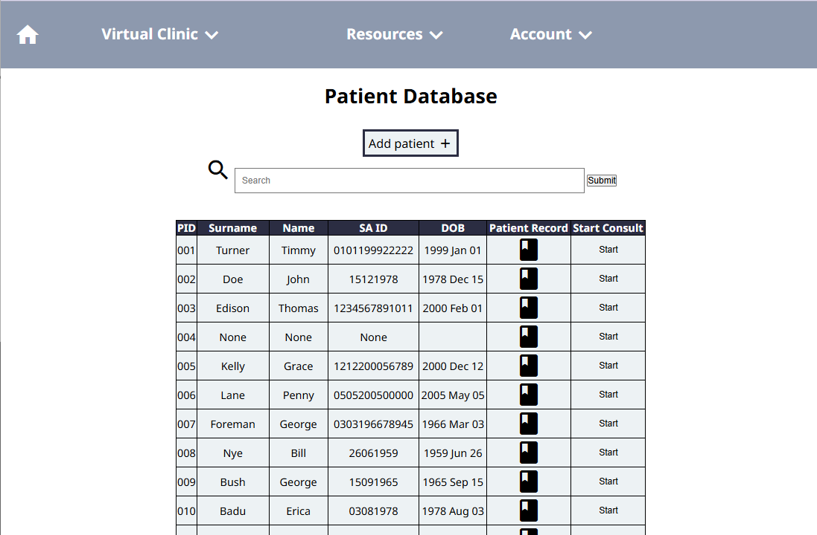
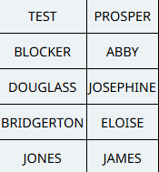

Slide 3
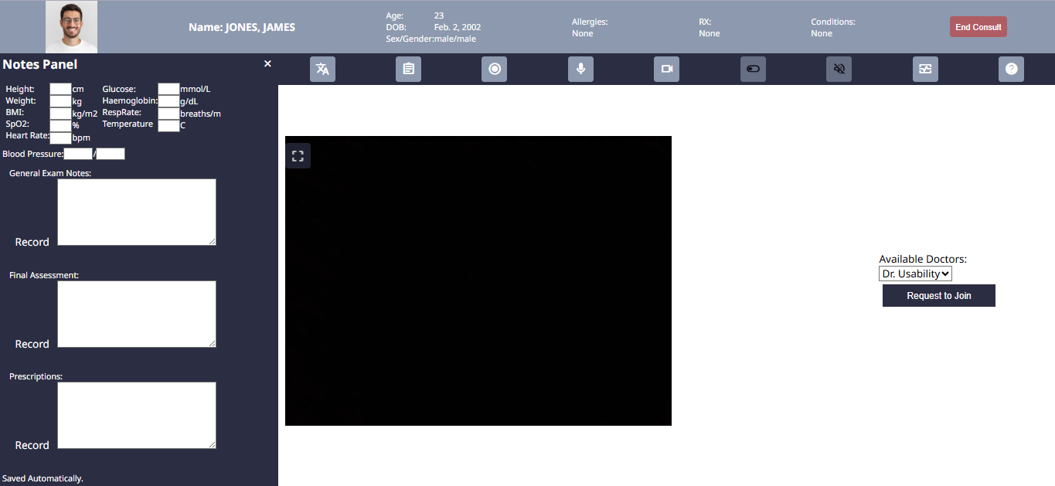
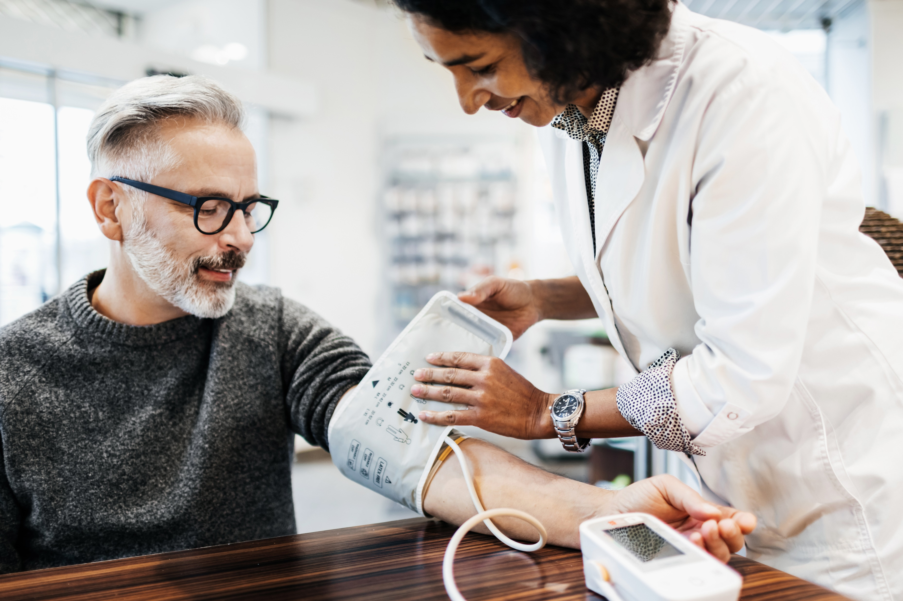


Slide 4
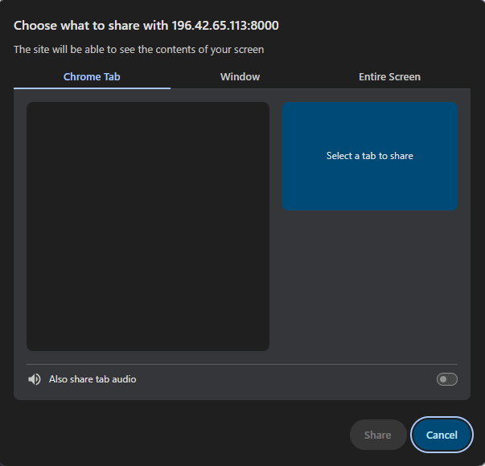

Slide 5
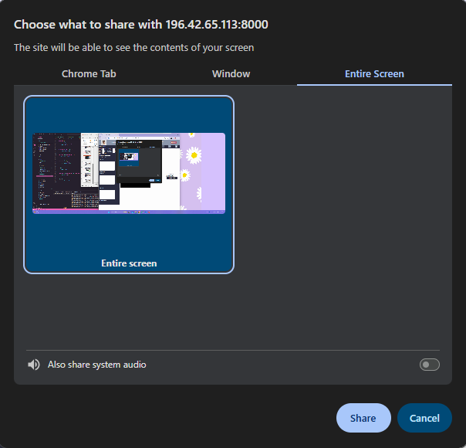

Slide 7


Slide 8
Great. Now let’s get started.
Your patient today speaks isiXhosa, and you and the doctor do not.
You’ll need to use the translation service provided by the virtual clinic to assist with communication.
Click to continue →

Slide 9
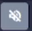
Start by opening the translation panel on the menu. (Hint: it’s the very first option on the menu)

Slide 10
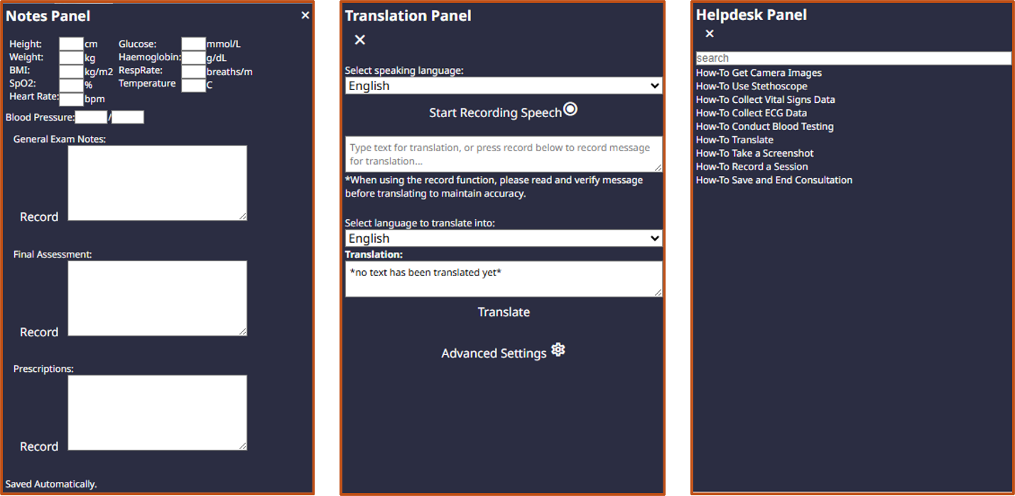
Great! Now, you can either capture spoken audio, or have the patient type in their message to translate it.
When possible, it’s recommended to use the typing option – its more accurate and faster.
Click to continue →

Slide 11
isiXhosa
The patient just typed their message.
Now, press the ‘translate’ button to translate what they’ve typed to English.
Yha, ngoku bendikhohlela nomqala obuhlungu isithuba esingangeveki.

Slide 12
isiXhosa
Great, the text is now translated to English.
Whenever there is translation, the results are automatically updated for the doctor to see as well.
Yha, ngoku bendikhohlela nomqala obuhlungu isithuba esingangeveki.
Yeah, so I’ve been having a cough and sore throat for about a week.
Click to continue →

Slide 13

isiXhosa
Given that the patient is complaining of a sore throat, the doctor wants to examine the ears and nose.
Use the medical camera with the otoscope attachment to do so.
Yha, ngoku bendikhohlela nomqala obuhlungu isithuba esingangeveki.
Yeah, so I’ve been having a cough and sore throat for about a week.

Slide 14
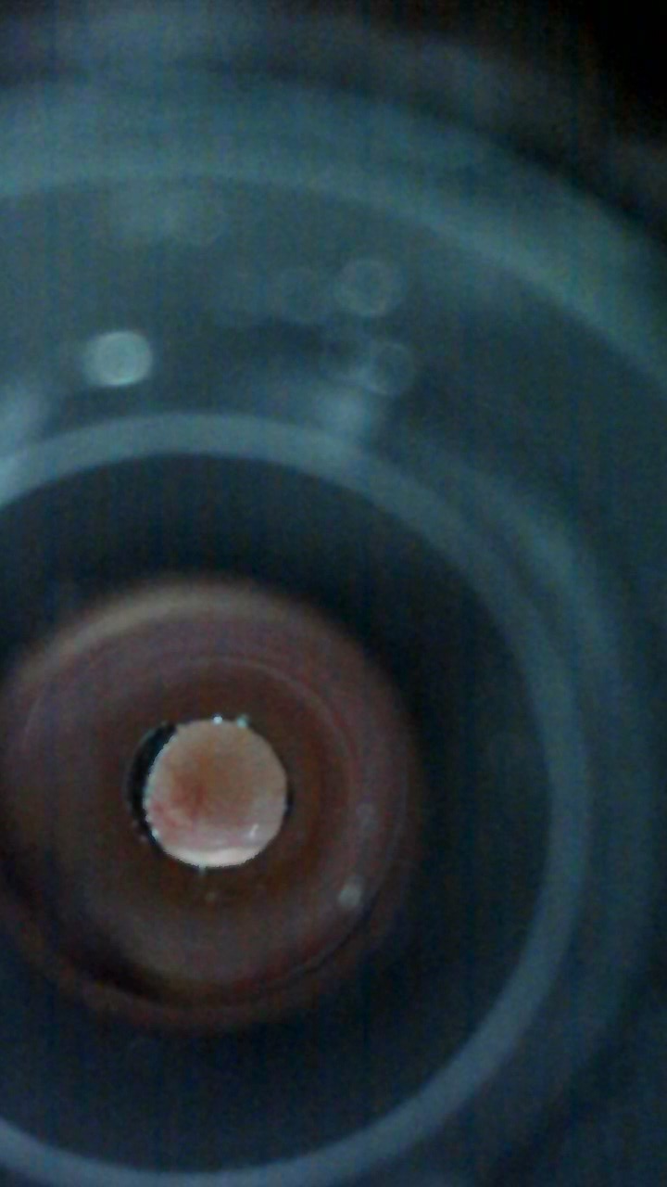
Great, you’ve now shared the image from the otoscope from the doctor.
You can screenshot the image and then turn the camera off.

Slide 15
Great, you’ve now shared the image from the otoscope from the doctor.
You can screenshot the image and then turn the camera off.

Slide 16
Great. Now the doctor wants to know the patient’s vital signs (heart rate, blood pressure, SpO2, and temperature).
Practice using the vital signs monitor to take the measurements. You do not have to enter the measurements here, though you would typically do so in a consultation.
Click to continue →

Slide 17
Based on the vitals and the otoscope images, the doctor doesn’t think there is anything to be concerned about.
However, he wants to check the breathing sounds with the stethoscope. Plug in the stethoscope and do an examination now.

Slide 18
Everything sounds okay – so you can go ahead and turn off the stethoscope now.

Slide 19
Ultimately, the doctor doesn’t think there is anything to be worried about – it’s likely a flu that will end in a few days. You can end the consultation now.

Slide 20
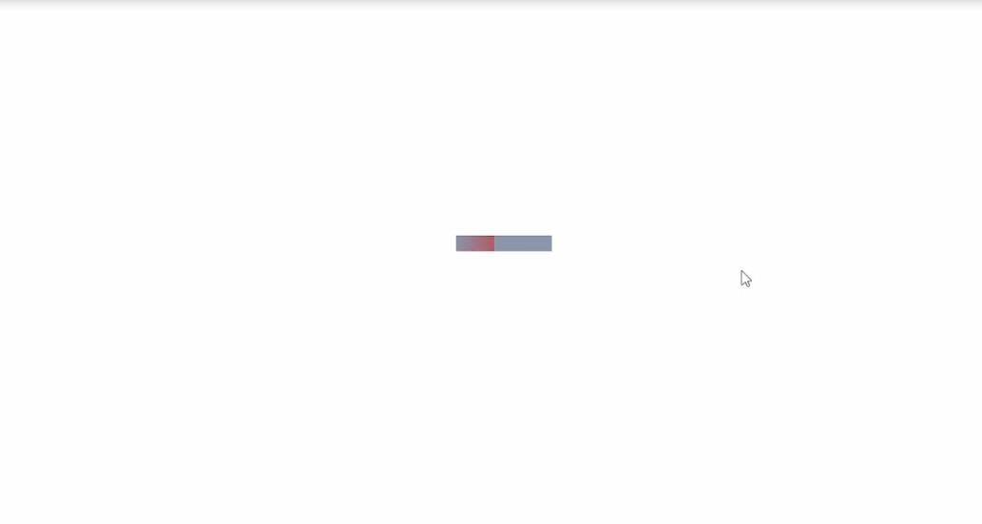
Click to continue →

Slide 21
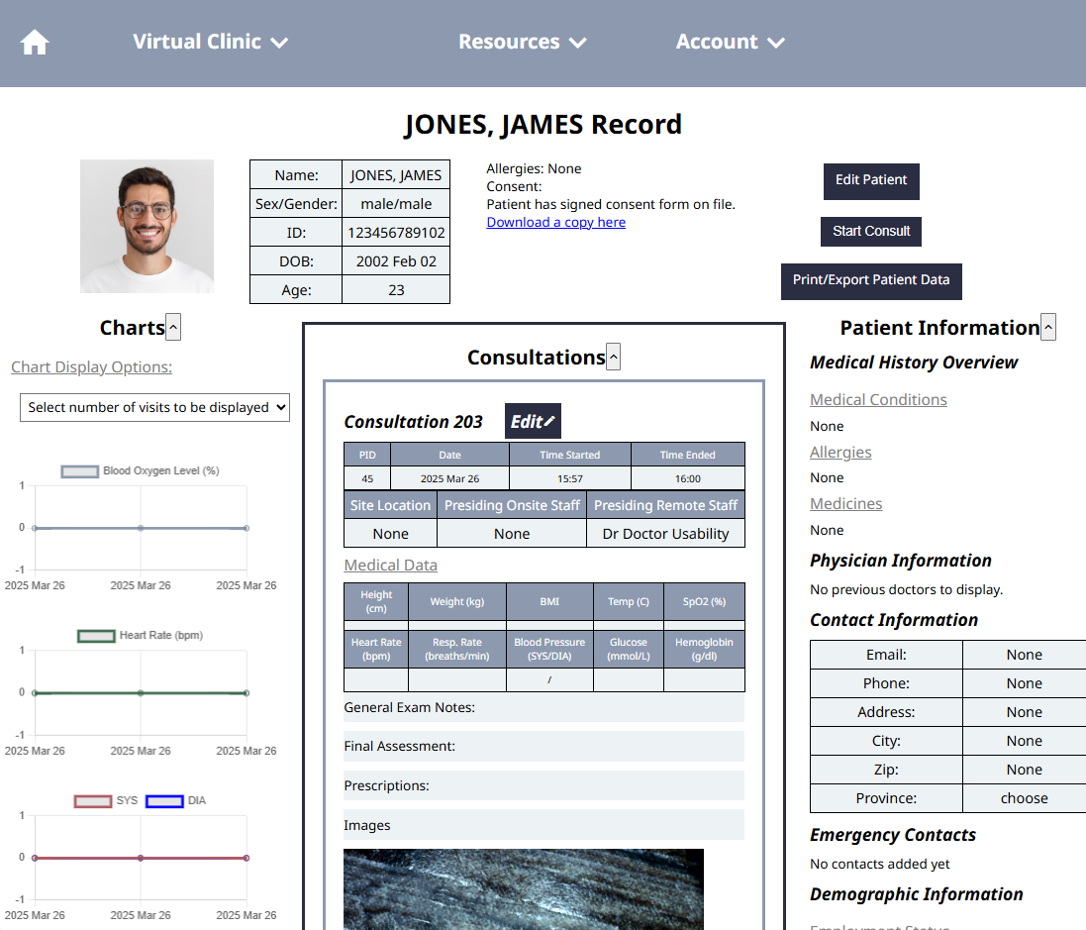
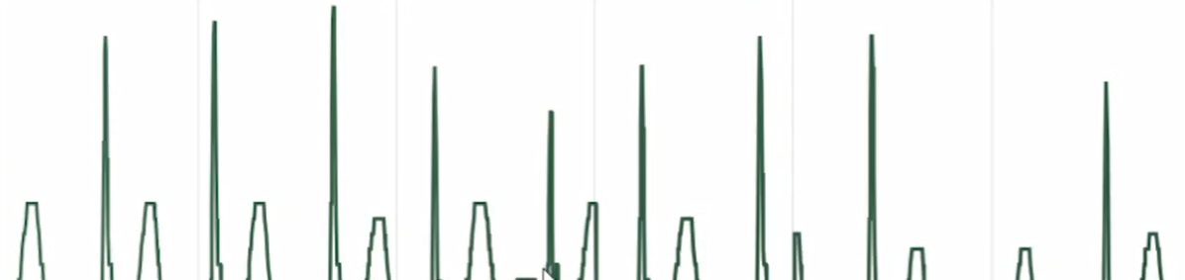
37
99
120
80
Click to continue →

Slide 22
Congrats! You have now finished all 4 tutorials.
You now know how to use the main features of the virtual clinic.
You are now ready to try real consultations!

